Slide 1


University of Basrah
Al-Zahraa Medical College
Ministry of higher Education and Scientific Research
Academic year 2021-2022
5th year
REPRODUCTIVE BLOCK
Lecture
Duration : 60 minutes
PUBERTY—Normal and Abnormal
Presented by
Dr. ABD ALKAREEM HUSSEIN SUBBER
Block staff:
Dr.Raya Muslim Al Hassan ( block leader)
Dr.Marwa Sadik (co leader)
Dr. Abdal kareem Hussain Subber
Dr.Alaa Hufdhi
Gynaecology by ten teacher 20th ed.
EDITION by Ten Teachers

Slide 2

University of Basrah
Al-Zahraa Medical College
Ministry of higher Education and Scientific Research
LEARNING OBJECTIVES
To define puberty
To understand the physiology of puberty
Describe the normal changes of puberty and the secondary sexual differentiation that accompanies it.
Understand the classification and causes of abnormal puberty and disorders of sexual development

Slide 3
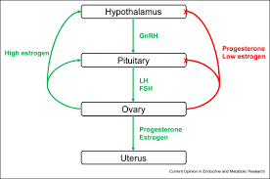
University of Basrah
Al-Zahraa Medical College
Ministry of higher Education and Scientific Research
DEFINITION
Puberty is the process of reproductive and sexual development and maturation that changes a child into an adult .Or :Normal physiologic transition from childhood to sexual and reproductive maturity
In this period there are gradual development of secondary sexual characters (development of the breast,sexual hair and genitalia )in addition to limited acceleration in body growth .
ENDOCRINOLOGY
During childhood, the Hypothalamic-Pitutary-Ovarian (HPO) axis is suppressed and levels of GnRH, FSH , LH, oestradiol are very low.
From the age 8–9 years GnRH is secreted from the hypothalamus in pulsations of increasing amplitude and frequency.
This stimulates secretion of FSH and LH by the pituitary glands ; which stimulates the production of oestrogen from the ovaries.
Oestrogen is responsible for the development of uterus, vagina, vulva, and also the breasts.
GnRH → FSH, LH → Oestradiol

Slide 4
University of Basrah
Al-Zahraa Medical College
Ministry of higher Education and Scientific Research
PYSIOLOGICAL CHANGES
The exact mechanism determining the onset of puberty is still unknown, but it is influenced by many factors including race, heredity, body weight , exercise., nutrional status, psychological factors and Leptin plays a role in the onset of puberty.
A girl, living in urban areas with good nutrition, adequate
body weight and whose mother and sisters have early
menarche, starts puberty early.

Slide 5
University of Basrah
Al-Zahraa Medical College
Ministry of higher Education and Scientific Research
Physical (somatic) changes of puberty:
The physical changes occurring in puberty are (in sequence of appearance):
Thelarche (breast budding): onset of breast development-an estrogen induced effect. This occur 2-3 years before menarche .
The growth : Growth of height in an adolescent girl is mainly due to hormones, adrenal hormones, growth hormone, estrogen, and insulin-like growth factor-1 .Adolescents, height is increased in acceleration from ages 10.5 to 13.5 years.
Adrenarche (Pubic and axillary hair growth ) :
The appearance of pubic hair is dependent on the secretion of adrenal androgens and is usually after thelarche

Slide 6
University of Basrah
Al-Zahraa Medical College
Ministry of higher Education and Scientific Research
Physical (somatic) changes of puberty:
The mean age of menarche is 12.8 years and it may take over 3 years before the menstrual cycle establishes a regular pattern.
Initial cycles are usually anovulatory and can be unpredictable and irregular.

Slide 7
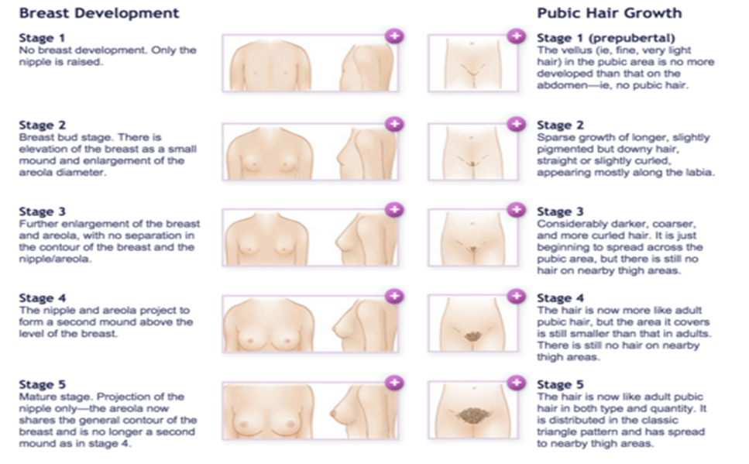
University of Basrah
Al-Zahraa Medical College
Ministry of higher Education and Scientific Research
Pubertal development of breasts and pubic hair is called Tanner stages , which are1–5.
All these changes are usually completed between the age of 10 years and 16 years.

Slide 8
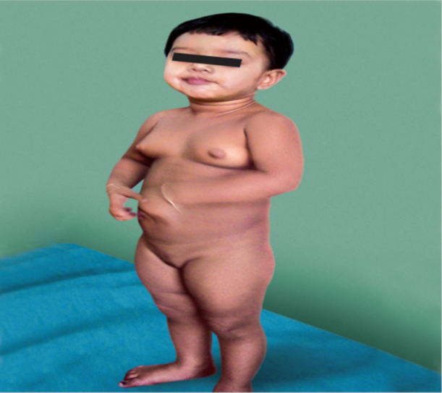
University of Basrah
Al-Zahraa Medical College
Ministry of higher Education and Scientific Research
Initial pubertal changes occur between 8 and 13 years .Changes before or after are categorized as either precocious or delayed puberty and warrant evaluation
COMMON DISORDERS OF PUBERTY
Precocious puberty
This is defined as the onset of puberty before the age of 8 in a girl or 9 in a boy. Precocious puberty is more common in girls (20 times) than boys.
It is classified as
1- Central or gonadotropin dependent:
Idiopathic or Constitutional
CNS lesions (25%): CNS malformation , trauma, infection (tuberculosis, encephalitis)
2- Peripheral. Gonadotrophin independent, is always pathological and can be caused by oestrogen secretion, such as exogenous ingestion or a hormone-producing tumour ( granulosa cell tumour, thica cell tumour ,androblastoma, adrenal hyperplasis or tumour, hepatoblastoma)

Slide 9

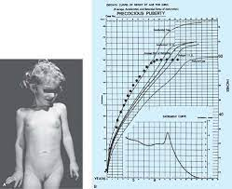
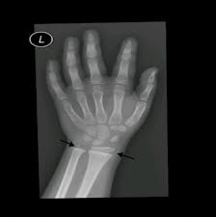
University of Basrah
Al-Zahraa Medical College
Ministry of higher Education and Scientific Research
Presentations
For the central causes, breasts and pubic hair develop with cyclic vaginal bleeding, while in peripheral causes, breasts may be develop and also pubic hair but no cyclic vaginal bleeding. precocious puberty leads to accelerated growth, accelerated bone maturation and ultimately reduced stature
Bone age assessment
Serum Oestradiol elevated
Serum FSH and LH as adult level
Pelvic and abdominal ultrasound ( ovarian or adrenal tumours)
Brain MRI and CAT scan
Diagnosis
Treatment
GnRH agonist Depot (goserelin or leuprolide )
monthly injection 3.75 mg

Slide 10

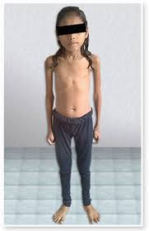
University of Basrah
Al-Zahraa Medical College
Ministry of higher Education and Scientific Research
Delayed puberty:
Delayed puberty is defined as no signs of secondary sexual characteristics by the age of 14 years
Causes
1-Hypogonadotrophic hypogonadism : May be constitutional, but other causes must be excluded: these include anorexia nervosa, malnutrition , excessive exercise and chronic illness, such as diabetes or renal failure. Rarer causes include a pituitary tumour, surgery, or radiation and Kalmans syndrome.
Diagnosis
low levels of FSH and LH and oestradiol level, pelvic ultrasound ( very small or infantile uterus
Treatment
treated with cyclic oestrogen. Unopposed oestrogen 0.625 mg (conjugated oestrogen) daily for 6 months , then combined oestrogen and progestin in sequential regimen

Slide 11


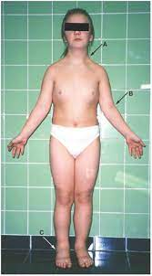
University of Basrah
Al-Zahraa Medical College
Ministry of higher Education and Scientific Research
2-Hypergonadotrophic hypogonadism
It is due to ovarian failure
Caused by
• Turner syndrome (45 XO) Short stature, facial dysmorphism, webbed neck, brachydactyly, heart defects; in cases of mosaicism, short stature may be the only sign; 45,X or related karyotype. Diagnosis :strak ovaries, absent or infantile uterus high FSH, LH low S oestradiol
XX gonadal dysgenesis
(It is a type of female hypogonadism in which no functional ovaries are present to induce puberty in an otherwise normal girl whose karyotype is found to be 46,XX. With nonfunctional streak ovaries, she is low in estrogen levels (hypoestrogenic) and has high levels of FSH and LH.
Premature ovarian failure
(autoimmune or metabolic disorder or following Infections like mumps or tuberculosis of ovary , Iatrogenic (post-surgery/chemo-radiotherapy

Slide 12

University of Basrah
Al-Zahraa Medical College
Ministry of higher Education and Scientific Research
Ambiguous genitalia is the external appearance of DSD
Disorders of sexual development (DSD)
Conditions with an atypical chromosomal, gonadal or phenotypic sex, which leads to differences in the development of the urogenital tract and different clinical phenotypes . The incidence is about 2 per 1,000.
Terminology for disorders of sex development
Female pseudohermaphrodite—( 46 XX) An association of female gonads with male external genitalia.
Male pseudohermaphrodite— ( 46 XY )An association of male gonads with female external genitalia.
True hermaphrodite—An individual possessing both ovaries and testes with ambiguity of genital organs.
Gonadal dysgenesis—abnormal gonads.
Etiology
either disorder of fetal endocrinology or disorder in gonadal development

Slide 13
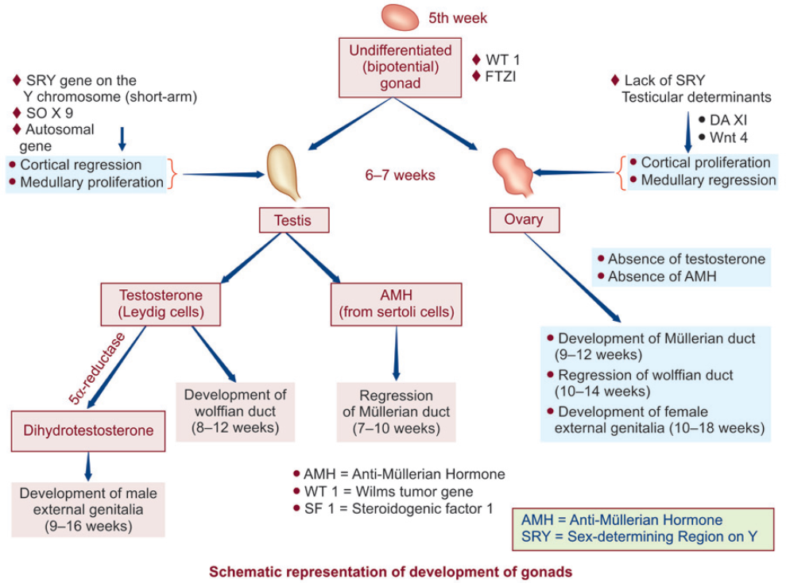
University of Basrah
Al-Zahraa Medical College
Ministry of higher Education and Scientific Research

Slide 14
University of Basrah
Al-Zahraa Medical College
Ministry of higher Education and Scientific Research
Presentations and types
1: Female pseudohermaphrodite
Genetic females (gonads ovaries) with masculinized external genitalia manifesting as—clitoral hypertrophy and some degrees of fusion of urogenital or labioscrotal folds e.g. as in congenital adrenal hyperplasia
Congenital Adrenal Hyperplasia
it is the most common cause of ambiguous sex in female
It is an autosomal recessive disorder (if any couple has had one affected child subsequent baby has 1 in 4 chance)
It is due to an enzyme deficiency in the corticosteroid production pathway in the adrenal gland , resulting in reduced levels of cortisol leading to hyperplasia of the adrenal glands. This leads to an excess of androgen precursors and then to elevated testosterone production. Raised androgen levels in a female fetus will lead to virilization of the external genitalia
Genotype = 46XX
Gonads = ovaries

Slide 15

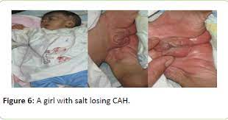
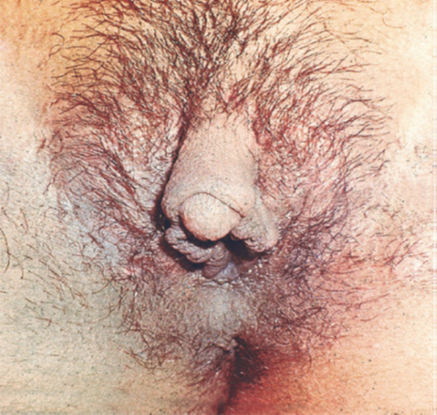
University of Basrah
Al-Zahraa Medical College
Ministry of higher Education and Scientific Research
Uterus and vagina are present, but remain
infantile therefore failure to menstruate. There is clitoromegaly and the genital folds fuse to form penile urethra rather than labia minora. Labia majora are fused which appears like scrotum
Pubic hair and axillary hair appear and voice deepens by the age of 2-4 years
Associated metabolic abnormalities decreased aldosterone leads to Hyponatremia,,Hyperkalemia, and Hypotension
Dx: Serum 17 hydroxy progesterone is elevated to beyond 800 ng/dL
sodium and chloride— low, potassium—raised).
Urinary excretion of pregnanetriol and 17 ketosteroids
are markedly elevated
Sex chromatin study: shows positive Barr body
Karyotype is 46, XX
Treatment with steroid and surgical correction

Slide 16
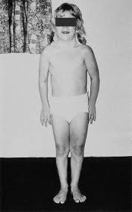
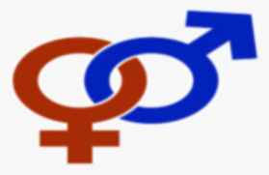
University of Basrah
Al-Zahraa Medical College
Ministry of higher Education and Scientific Research
Non-structural causes of DSD
Turner syndrome
The total number of chromosomes is 45 in Turner syndrome, which results from a complete or partial absence of one X chromosome (45XO).
Turner syndrome is the most common chromosomal anomaly in females
Clinical features include short stature, webbing of the neck and a wide carrying angle. Associated medical conditions include coarctation of the aorta, inflammatory bowel disease, sensorineural and conduction deafness, renal anomalies and endocrine dysfunction, such as autoimmune thyroid disease.
Ovaries streak gonads’ and do not function to produce oestrogen or oocytes.

Slide 17
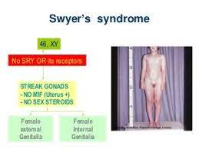
University of Basrah
Al-Zahraa Medical College
Ministry of higher Education and Scientific Research
46XY gonadal dysgenesis
In this situation, the gonads do not develop into a testis, despite the presence of an XY karyotype
In complete gonadal dysgenesis (Swyer syndrome), the gonad remains as a streak gonad and does not produce AMH and testosterone. (AMH), the Müllerian structures do not regress and the uterus, vagina and Fallopian tubes develop normally. The absence of testosterone means the fetus does not virilize. The baby is phenotypically female, although has an XY chromosome. The gonads do not function and presentation is usually at adolescence with delayed puberty
The dysgenetic gonad has a high malignancy risk and should be removed when the diagnosis is made

Slide 18
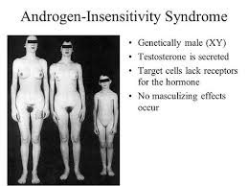
University of Basrah
Al-Zahraa Medical College
Ministry of higher Education and Scientific Research
46XY DSD
complete androgen insensitivity syndrome (CAIS)
In the fetus with CAIS, testes form normally due to the action of the SRY gene
testes secrete AMH, leading to the regression of the Müllerian ducts. Hence, CAIS women do not have a uterus
Testosterone is also produced; however, due to the inability of the androgen receptor to respond, the external genitalia do not virilize and instead undergo female development.
The baby is born with normal female external genitalia, an absent uterus and testes that are found in the abdomen from the pelvis to the inguinal canal.
Presentation is usually at puberty with primary amenorrhoea, although if the testes are in the inguinal canal they can cause a hernia in a younger girl
Treatment counsel the family and psychological support. Gonadectomy should be done

Slide 19
University of Basrah
Al-Zahraa Medical College
Ministry of higher Education and Scientific Research

Slide 20
University of Basrah
Al-Zahraa Medical College
Ministry of higher Education and Scientific Research
5-Alpha-reductase deficiency
The fetus has an XY karytype and normal functioning testes that produce both testosterone
and AMH. However, the fetus is unable to convert testosterone to dihydrotestosterone in the peripheral tissues and so cannot virilize normally
Presentation is usually with ambiguous genitalia at birth, but can also be with increasing virilization at puberty of a female child
the genitalia where a male is born with an underdeveloped penis

Slide 21
University of Basrah
Al-Zahraa Medical College
Ministry of higher Education and Scientific Research
TRUE HERMAPHRODITISM
Both the testicular and ovarian tissues are present in an individual in different combinations.
The common presentation is ambiguity of external genitalia and under musculinization
75% develop gynecomastia and nearly 50% menstruate
Sex chromatin is usually positive.
Karyotype is usually 46, XX (70%), rest are 46, XY and rarely mosaic XX/XY.

Slide 22
University of Basrah
Al-Zahraa Medical College
Ministry of higher Education and Scientific Research

Slide 23
University of Basrah
Al-Zahraa Medical College
Ministry of higher Education and Scientific Research

Slide 24
University of Basrah
Al-Zahraa Medical College
Ministry of higher Education and Scientific Research

